Slide 1
Greedy Algorithm
Nahian Salsabil

Slide 2
Brute Force Recap
Checks all possible solutions and finds out the best one.
Time consuming
Ensures the best possible solution.

Slide 3
Greedy Algorithm
Applied in optimization problem.
Optimization means either minimization or maximization.
Example: Shortest Path, Minimum Cost Spanning Tree
Both are Minimization problem
Does not check all the solutions
Applies an immediate solution at each stage based on a specific criteria without considering future consequences.
Once the stage is passed, doesn’t look back.
Does not always guarantee the optimal solution.
Less time complexity. Usually O(n) or O(nlogn)

Slide 4
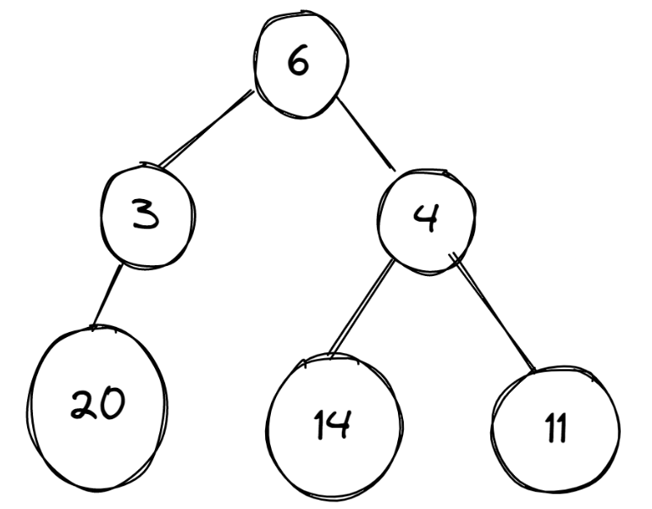
Example
Problem:
Find the greatest value from the graph.

Slide 5
Example
Problem:
Find the greatest value from the graph.
Solution:
Greedy Approach
Not Greedy Approach

Slide 6
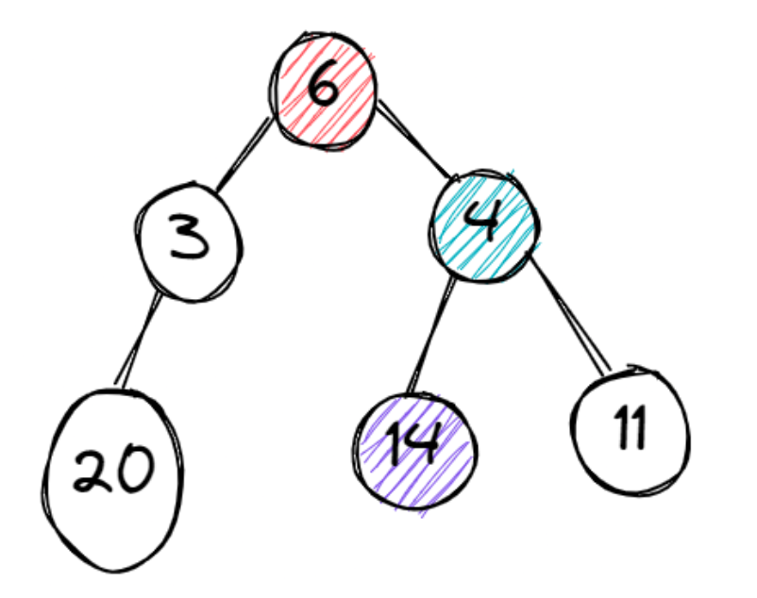
Greedy Approach
The first node it chooses is 6.
Then there are two options to choose -
3 and 4. Greedy will choose 4 as 4 is
the greatest.
Then it will choose 14 among 14 and
11 as 14 is the greatest.
So, the Solution is 14.

Slide 7
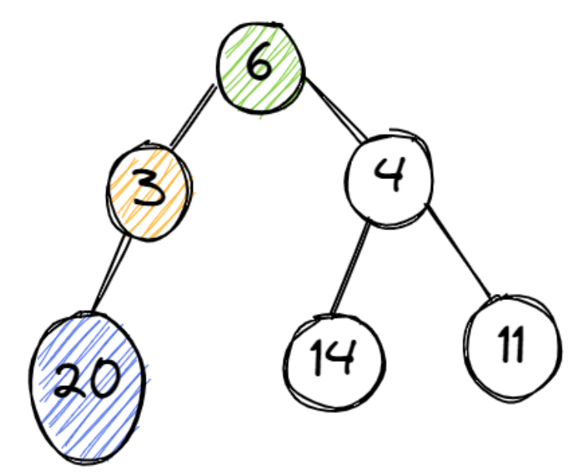
Not Greedy Approach
The first node it chooses is 6.
Then it chooses 4 among 3 and 4.
And then 14. It will keep the 14 aside.
Then it will again start from 6 and this
time it chooses 3. Then it chooses 20.
Now comparing 20 and 14, it chooses 20.
So, the solution is 20.

